Slide 1
Adversarial Physics.
Design Masterclass.
Ubisoft.
Samuel Cook and Will Terry.

Slide 2
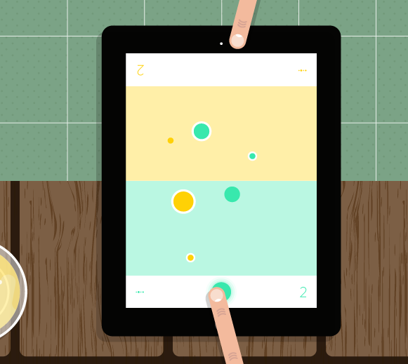
OLO
Trial and error
Bouncing/ Richocet
Game of skill
Strategy
Fast
Turn based
Simple controls

Slide 3
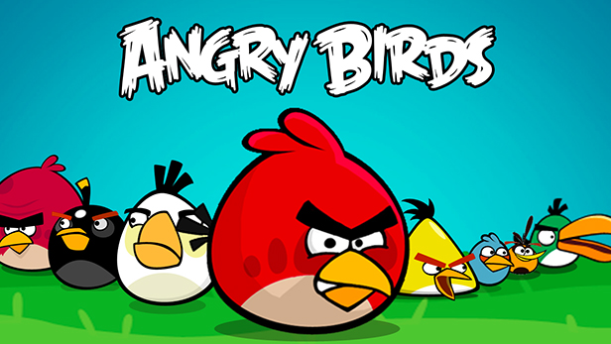
Angry Birds
Trial and Error.
Simple Controls.
Destruction.

Slide 4
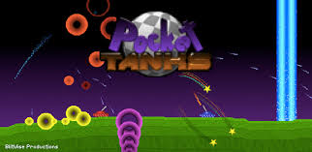
Pocket Tanks
Customisable weapons
Replayability.
Destructible terrain.
Easy UI.
Turn Based.
Trial and Error.

Slide 5
World of goo

Slide 6
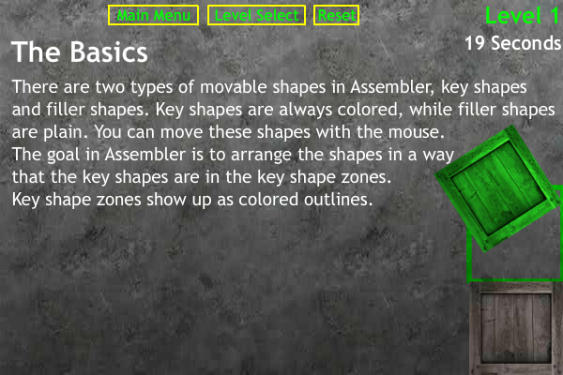
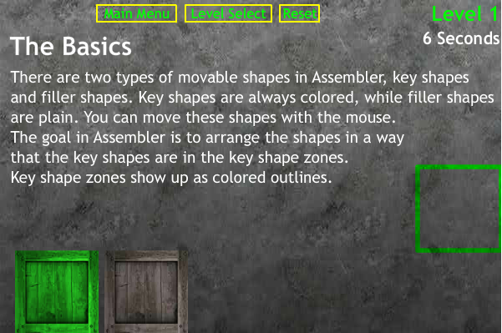
Assembler 3
Physics object stacking
Single Player
Minimal UI
(no text in latter levels)
Physics crates are fun.

Slide 7
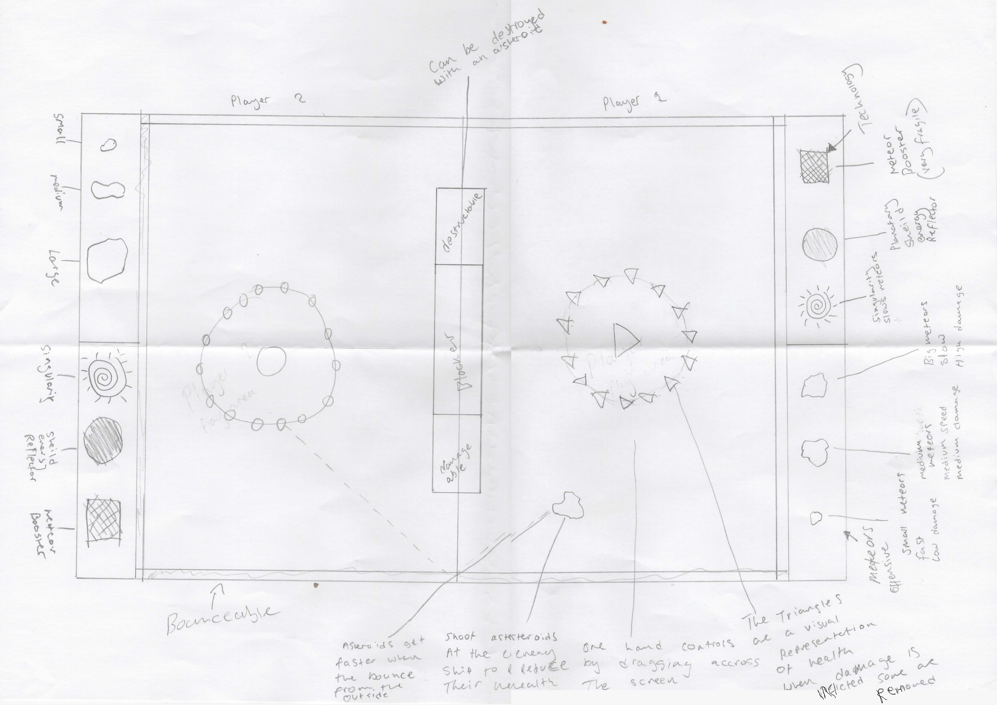
Bringing it all together Elements we want in our Game
Trial and Error.
Simple Controls.
Simultaneous play.
Bouncing / Richochet.

Slide 8
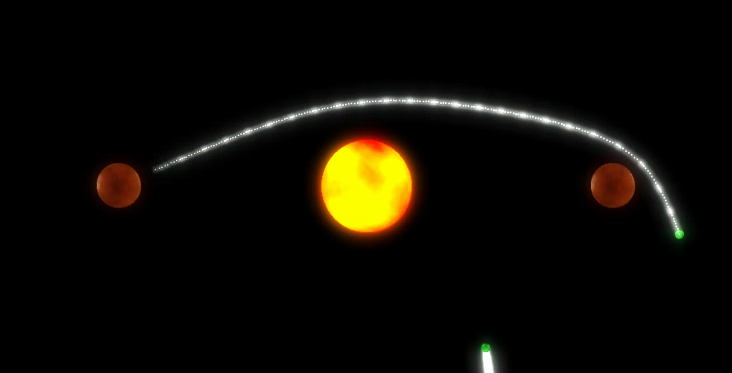
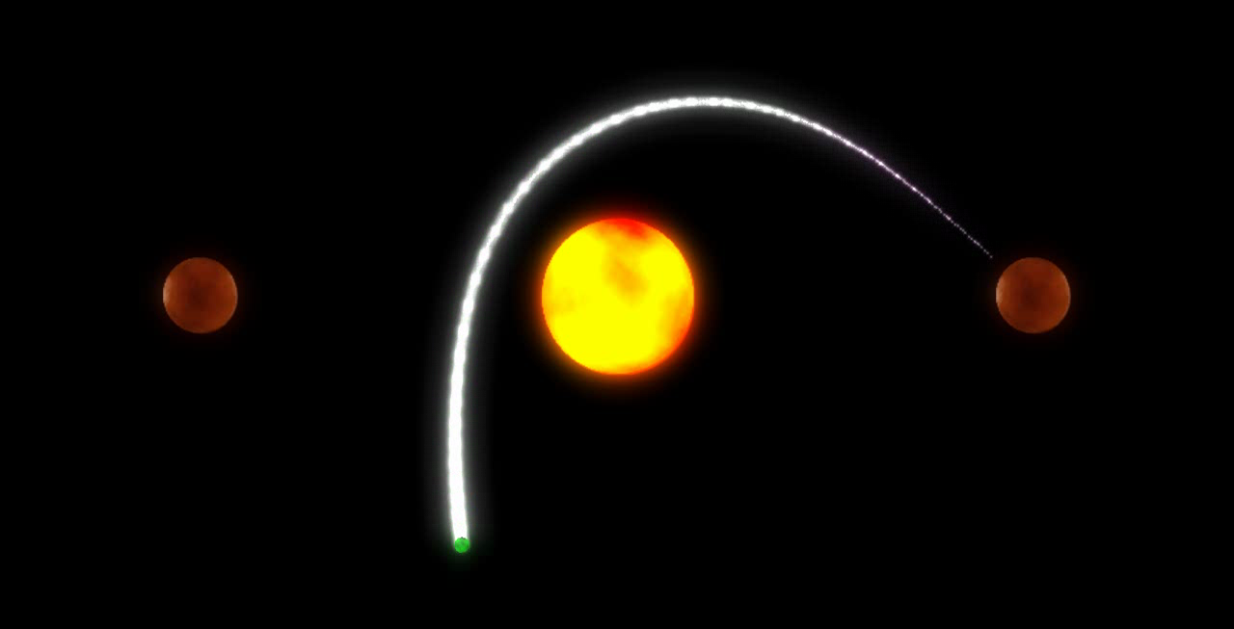
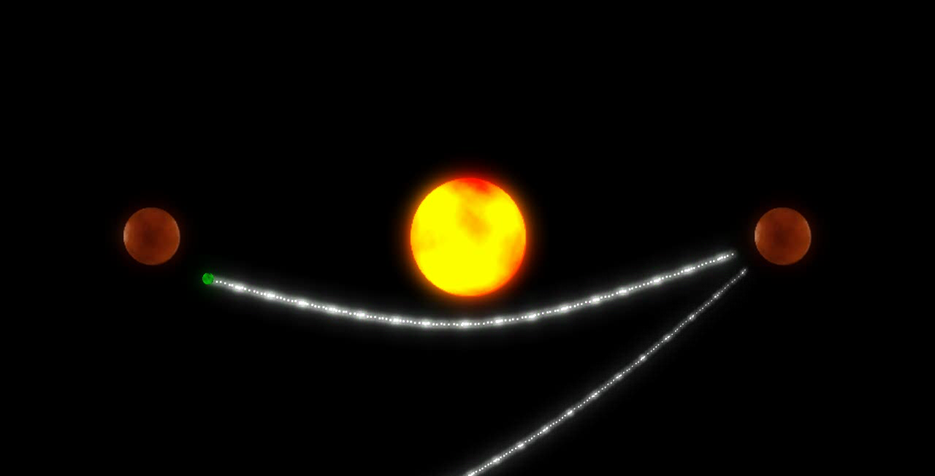
Prototype 1: Orbital Gravity
Mix between Tanks and Kerbal Space Program
Mobile Game
Player Skill

Slide 9
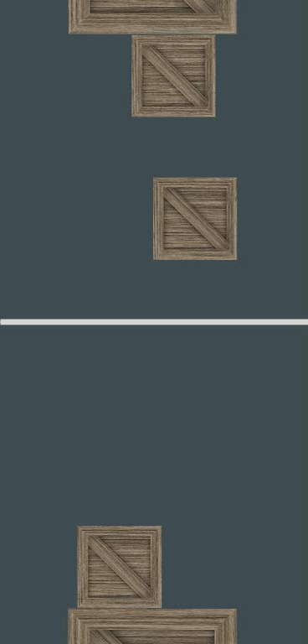
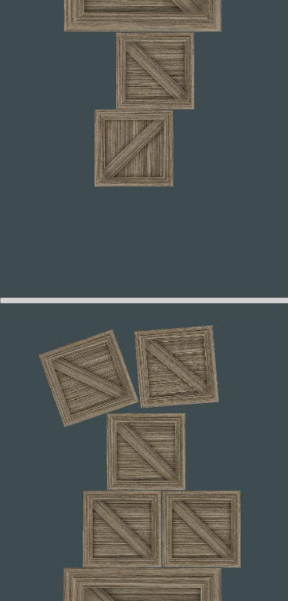
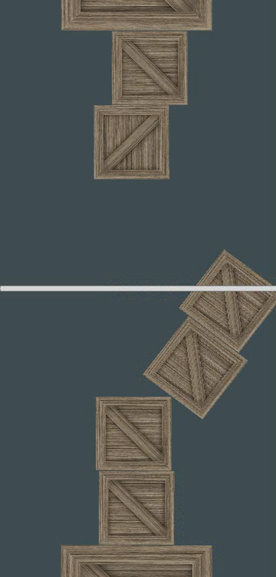
Prototype 2: Crate Stacking
Players build towers
First to build a certain height wins
Split-screen
Mobile/Touchscreen

Slide 10
Prototype 3

Slide 11
Conclusion

Slide 12
Questions?

